Slide 1
한국어 지부
How to Make Money out of Open Source Software?
28th, Oct 2011
FOSS4G Korea 2011 Keynote Talk
OSGeo Korean Language Chapter
Shin, Sanghee(endofcap@gmail.com)

Slide 3
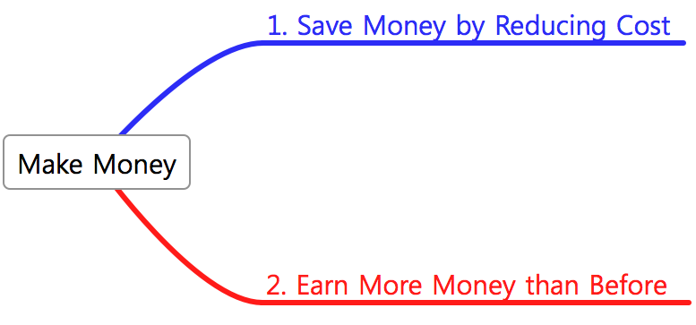

Slide 4
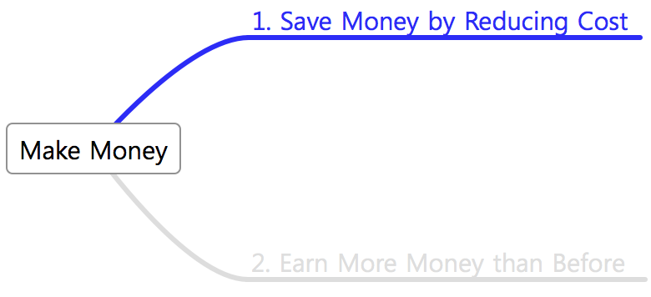

Slide 6
IBM committed USD 1Billion to open source in 2001

Slide 7
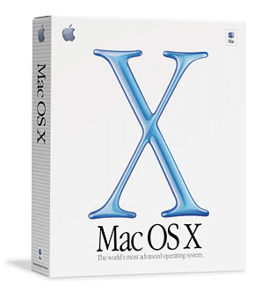
OS X is built on top of 2 key open source projects, Mach3 & FreeBSD 3.2

Slide 10
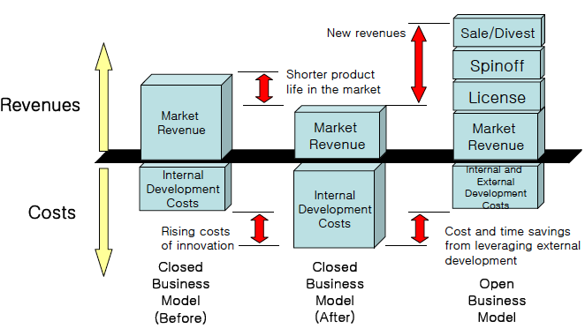
Lower cost of innovation
Faster time to market
Share risk with others

Slide 11
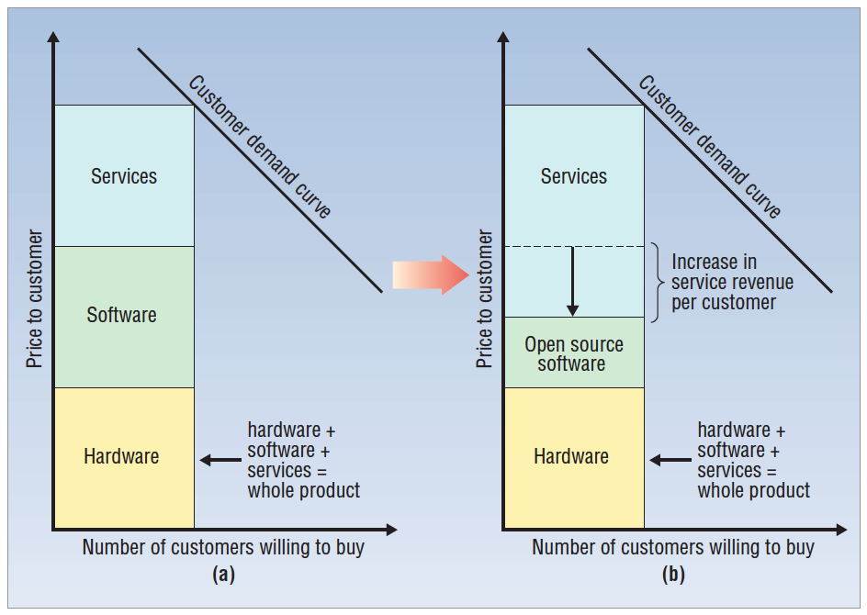

Slide 12
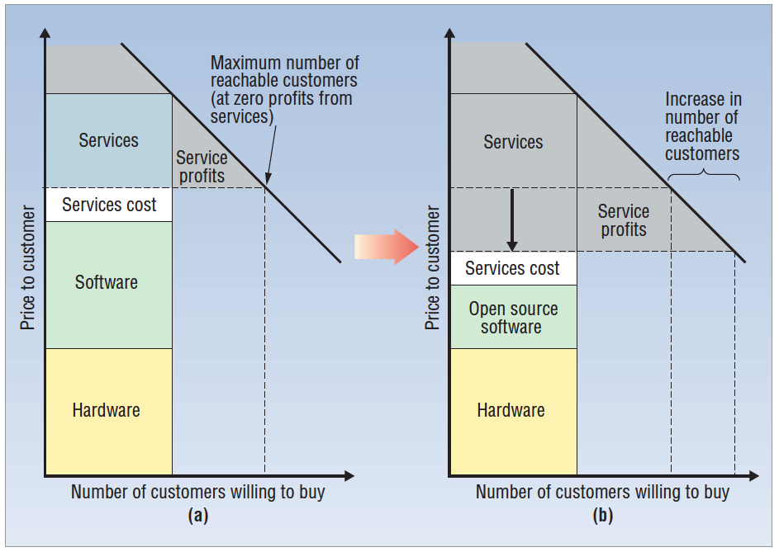

Slide 13
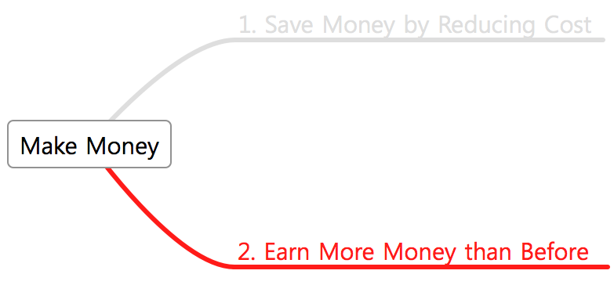

Slide 14
Let’s sell open source SW at high price like 봉이 김선달!!

Slide 15
Price
Price
Demand Curve
Demand Curve
Supply Curve
Supply Curve 1
Supply Curve 2
Quantity
Quantity
This is Free Economy!!

Slide 16
Changing ‘Free’ to ‘Paid’?

Slide 17
“If it’s digital, sooner or later it’s going to be free. ”
Abundance wants to be free!!

Slide 18
And then how can we earn money out of ‘Free’?

Slide 19
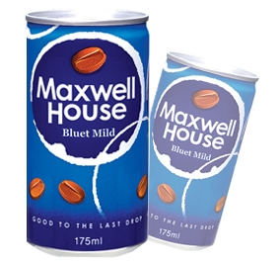
Free
KRW 800
KRW 5,000

Slide 20
KRW 3,500
KRW 120,000
KRW 1,995,000

Slide 21
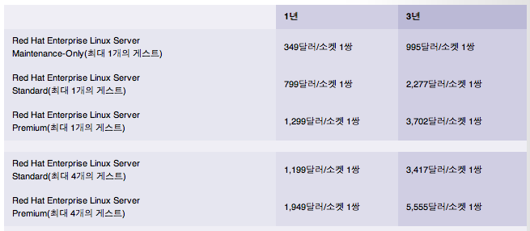
USD 4.95
Free
What makes this difference?

Slide 22
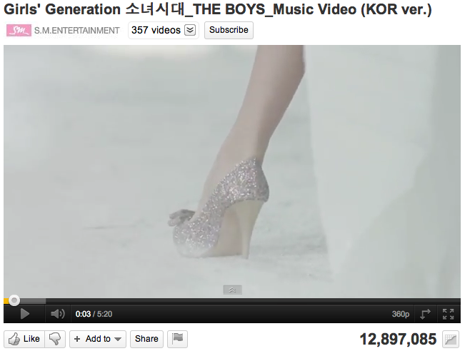
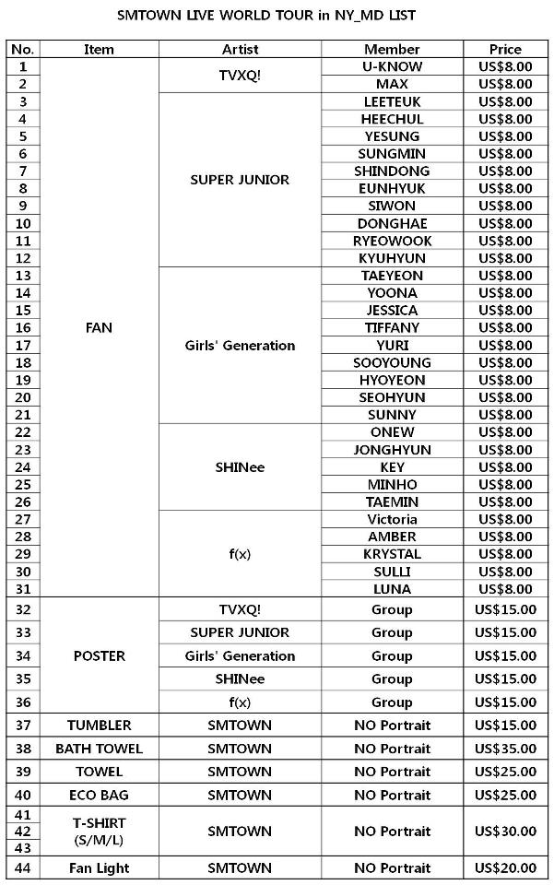
Give away Music!
Earn money from concerts & goods!!

Slide 23
Culture
Brand
Reliability
Experience

Slide 24
Scarcity want to be Expensive!
In abundance,
People want something special!

Slide 26
Ok!!
Let’s make something special using open source S/W?
But,
How??

Slide 28
Community Open Source Software Developing Model
Roadmap
Design
Software
‘The Project’
Core Developers
Contributions
Community
Administrators
Engineers
Contributions
Peer Review
Use Cases
Testing
Documentation
Translations
Features
Forum Help
Bug Fixes
Of the developers, by the developers, for the developers!!
* Source : James Dixon, The Beekeeper

Slide 29
Open Source Software Advantages over Proprietary
* Source : Barracuda Networks
Price & opened source code are key factors!

Slide 30
Proprietary Software Advantages over Open Source
* Source : Barracuda Networks
Professional services & convenience are key factors!

Slide 31
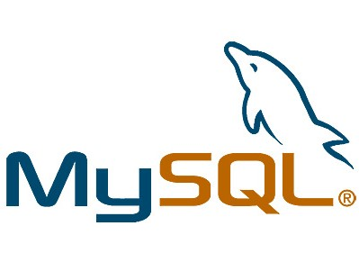
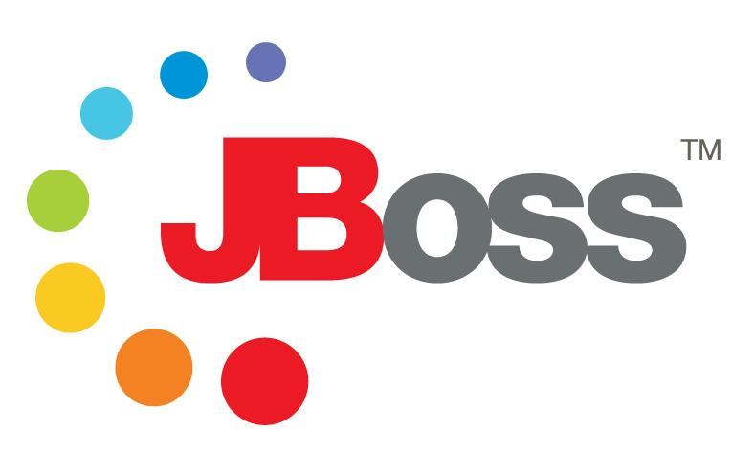
6 Barriers
Open Source SW
Success Story
1. Lack of formal support and services
2. Velocity of change
3. Lack of roadmap
4. Functional Gaps
5. License Types
6. Lack of endorsements by independent ISVs
* Source : Ray Lane, 6 barriers to open source adoption

Slide 32
Commercial Open Source Software
Advantages
of
Proprietary
Professional service
Continuous support
Easy to use
Reliability
Functionalities
Advantages
of
Open Source
Cheaper price
Source code access
Community review
Quicker bug fix
More standard based
‘Whole Product’
Commercial open source company can exist to create ‘Whole Product’ around an open source project (software + community) and can deliver it to a mainstream market.

Slide 33
Installation
Integration
<Open Source SW>
Support
Services
Software
Software
Other
SW/HW
VARs
Certification
Training
<Whole Product>
OSS model is great at producing SW, but it doesn’t produce ‘Whole Product’ for customers!

Slide 34
Actual Product
(Quality, design, brand, packages)
Core Product
(Basic functions, symbols, experiences)
Whole Product
(Additional services)
Market Offering
(Additional benefits offered by partners)

Slide 35
Commercial Open Source Software Business Model
Community can hear more functionalities & requests
+
The bigger community
the more resources
Commercial Open Source Company
Open
Source
Software
Community
‘Go To Market’
Sales, Marketing, Support, Services, Engineering, Product Mgmt.
Customers
Partners
OEMs
+
+
Customers can gain higher quality software at a better price
Making whole products with open source community!!

Slide 36
Next Demand
ACCESS
SKILL
MONEY
Customer
TIME
Next Market
Targeting pains of real customers or pursuing the scarcity with OSS!!

Slide 37
Thank You!!!

